Slide 1
Making GIS web apps
(at DWR)

Slide 2
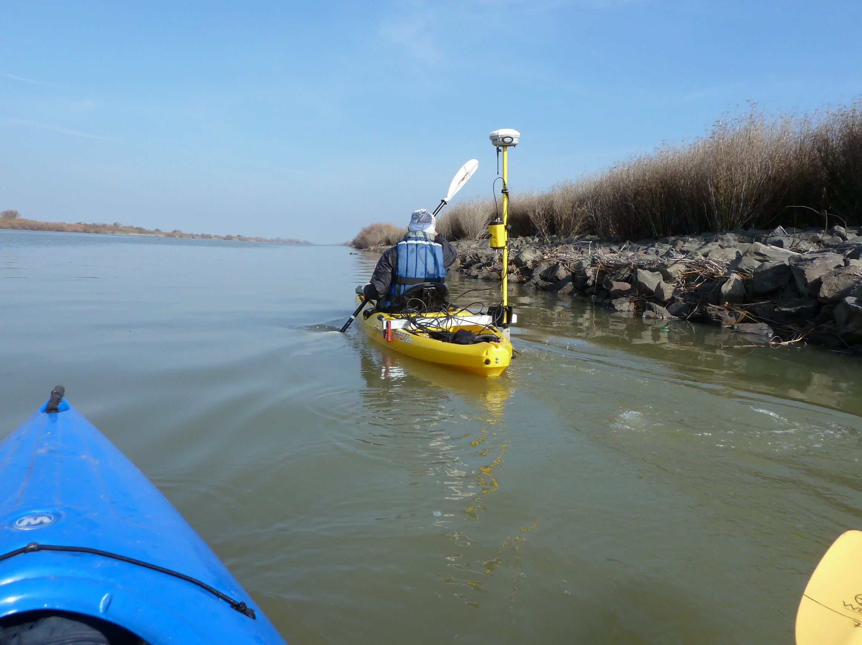
Who is this guy
Wyatt Pearsall
https://github.com/wpears

Slide 3
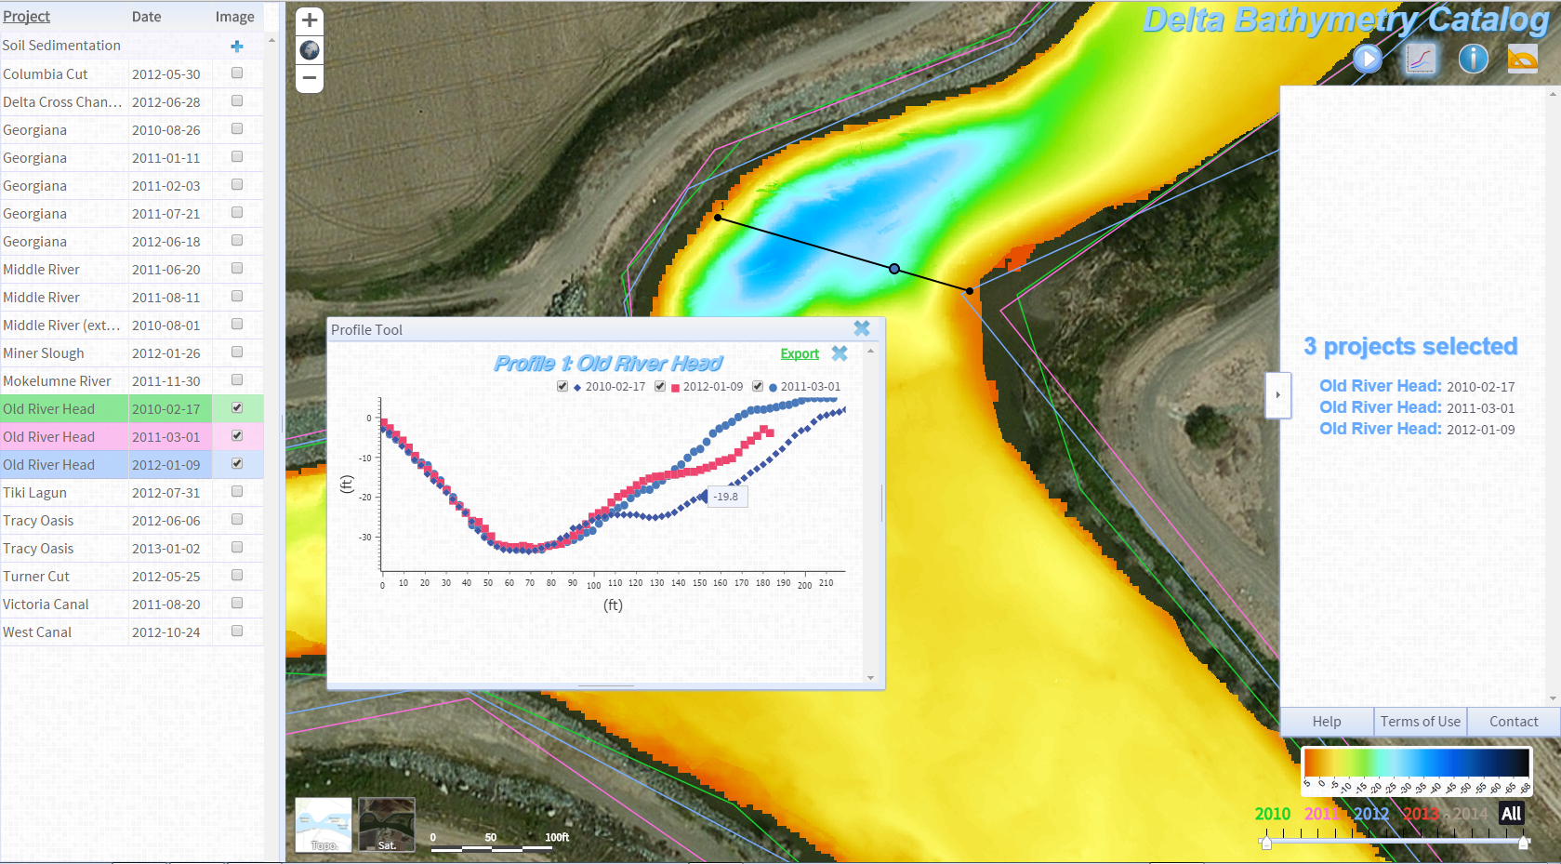

Slide 4


Slide 5
Why web apps
…really, why web apps?

Slide 6


Slide 7


Slide 8
Why web apps
Web apps turn data into information

Slide 9
Why web apps
FTP
Catalog
“Email me”

Slide 10

Why web apps
FTP
Catalog
“Email me”

Slide 11
Why web apps
Interactivity

Slide 12

Why web apps
Interactivity

Slide 13
Why web apps
Interactivity
Visualization

Slide 14

Why web apps

Slide 15
Why web apps
Interactivity
Visualization
Audience

Slide 16

Why web apps

Slide 17
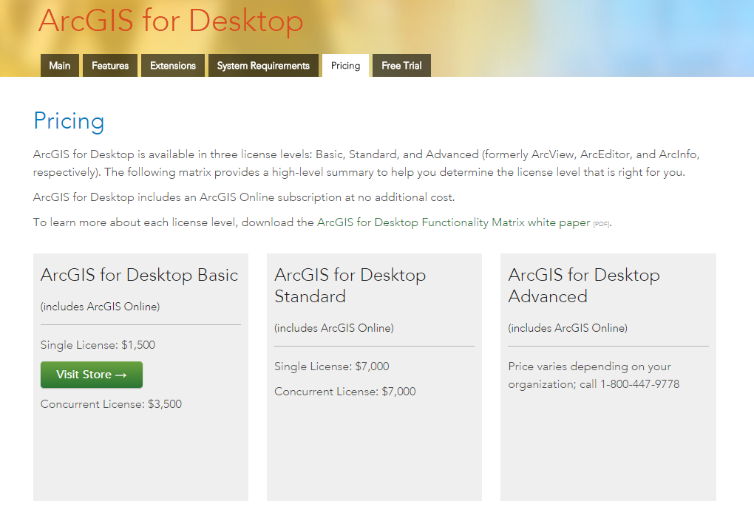
Why web apps

Slide 18
How do web apps work

Slide 19
How do web apps work
Navigate to application URL
App loads, runs in the browser
Retrieves data from server
Formed of HTML, CSS, and JS

Slide 20
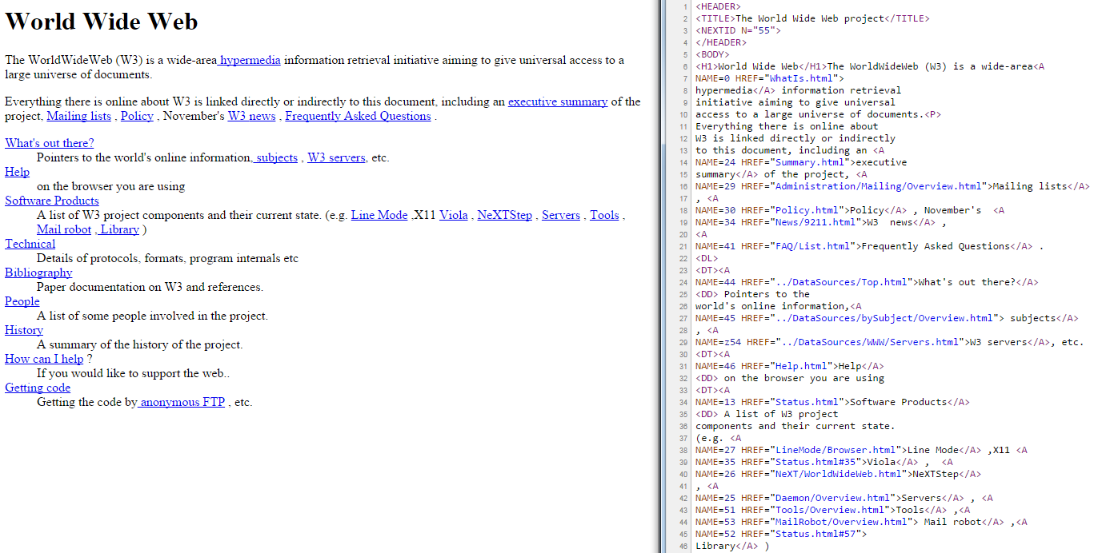
How do web apps work
HTML, the backbone of the web

Slide 21
HTML
Hierarchy of information
Browser interprets to create
webpage structure
How you include other files

Slide 22
How do web apps work
HTML, the backbone of the web
CSS, Cascading Style Sheets

Slide 23
CSS
Applies styles to HTML tags
Responsible for webpage layouts

Slide 24
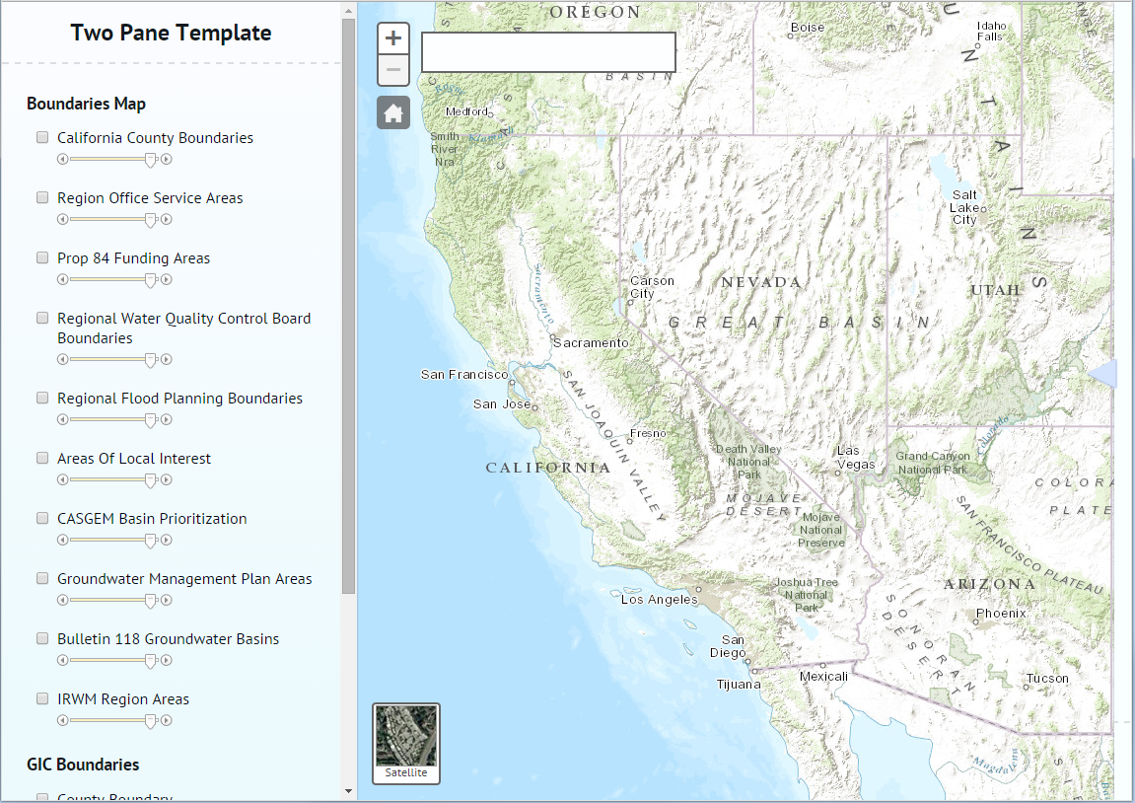

Slide 25
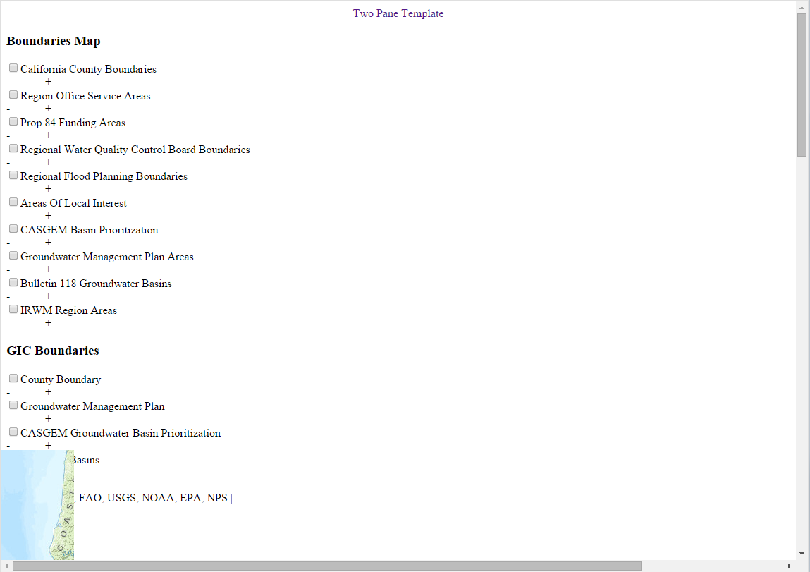

Slide 26
How do web apps work
HTML, the backbone of the web
CSS, Cascading Style Sheets
JavaScript, makes an app an app

Slide 27
JavaScript
Most interactivity in webpages
Find, create, and remove HTML
elements through the “DOM”
In a web map, responsible for
drawing layers, panning,
zooming, querying data, etc.

Slide 28
What about plugins
Plugins live in <object> or
<embed>
Managed separately from browser
Use their own programming
languages

Slide 29
What is a server
A program on a computer that accepts requests and returns responses

Slide 30
What is a server
Send a request with parameters
Web server receives and
processes your request
Responses with appropriate file or
data

Slide 31
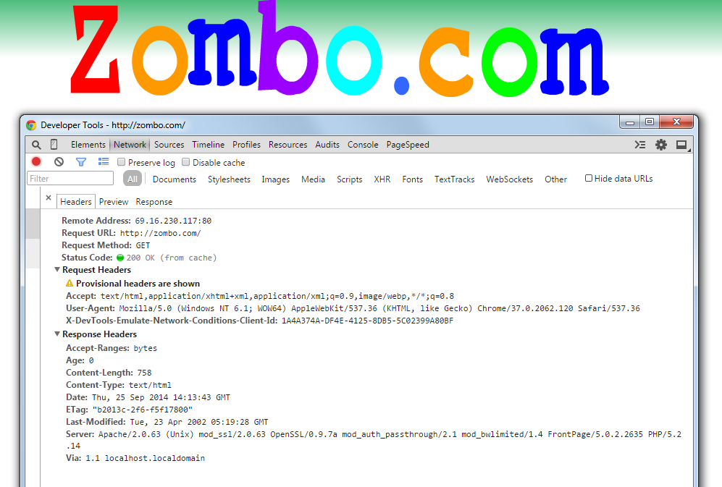
What is a server

Slide 32
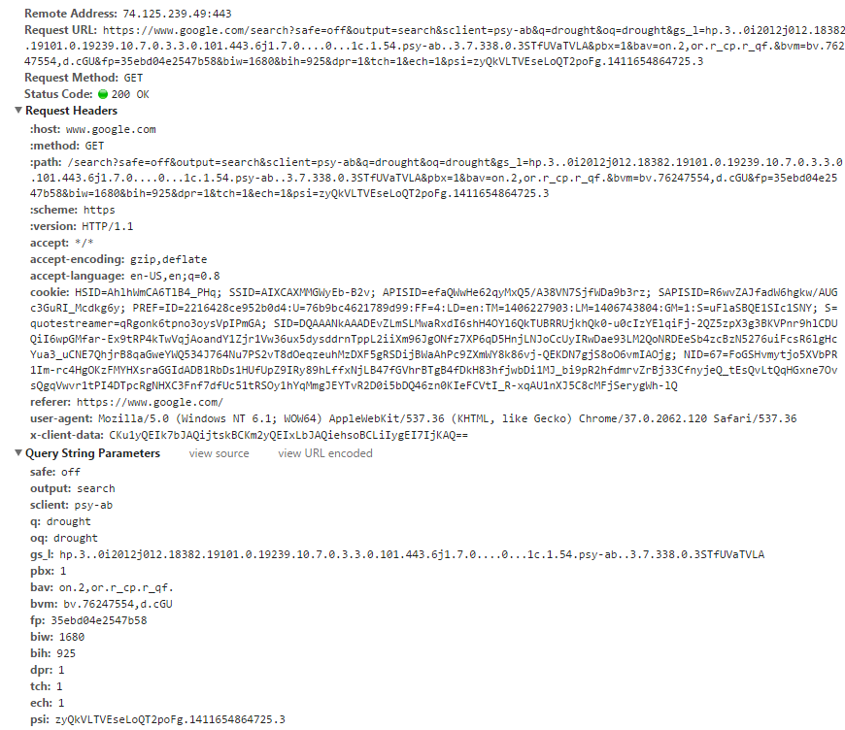

Slide 33
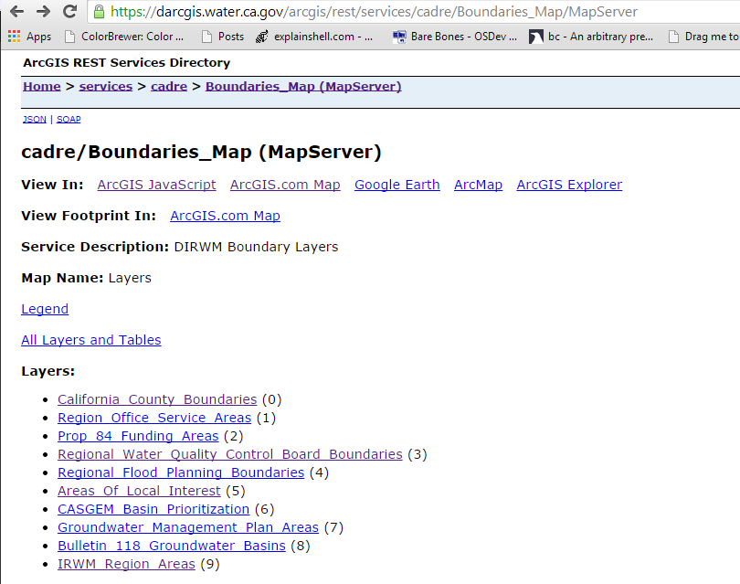
ArcGIS Server
Services accessed through URLs

Slide 34
ArcGIS Server
Operations through URLs
https://darcgis.water.ca.gov/arcgis/rest/services/cadre/Boundaries_Map/MapServer/0/query?where=1%3D1&text=&objectIds=&time=&geometry=&geometryType=esriGeometryEnvelope&inSR=&spatialRel=esriSpatialRelIntersects&relationParam=&outFields=&returnGeometry=false&maxAllowableOffset=&geometryPrecision=&outSR=&returnIdsOnly=false&returnCountOnly=false&orderByFields=&groupByFieldsForStatistics=&outStatistics=&returnZ=false&returnM=false&gdbVersion=&returnDistinctValues=false&f=html

Slide 35
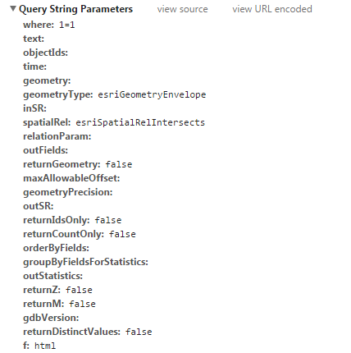
ArcGIS Server
Operations through URLs

Slide 36
ArcGIS Server
Stay tuned for the demo!

Slide 37
Web maps at DWR

Slide 38
Web maps
ArcGIS Online
Portal for ArcGIS
Custom application

Slide 39
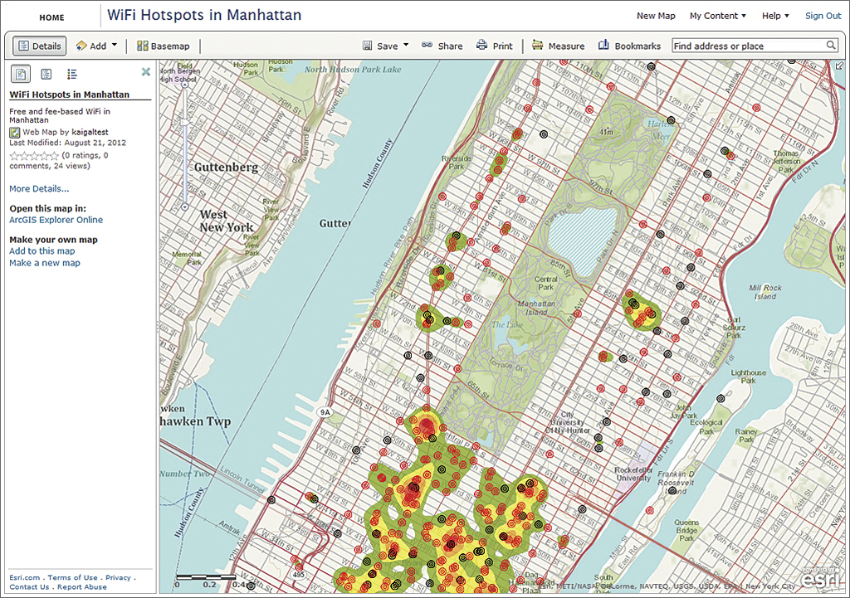
AGOL / Portal
Create simple apps quickly

Slide 40
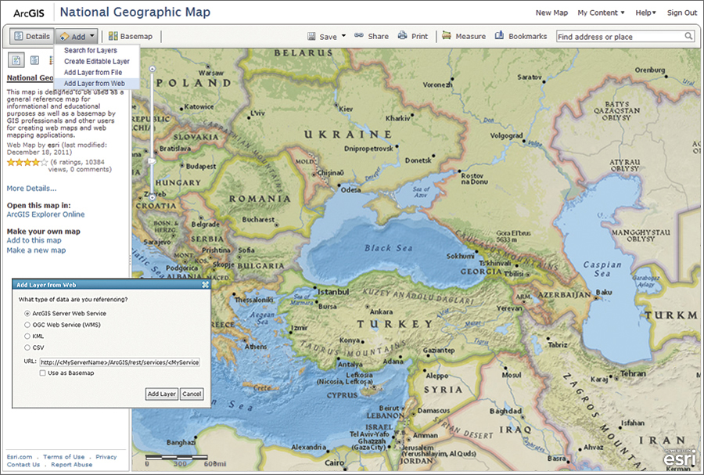
AGOL/Portal
… but hard to customize

Slide 41

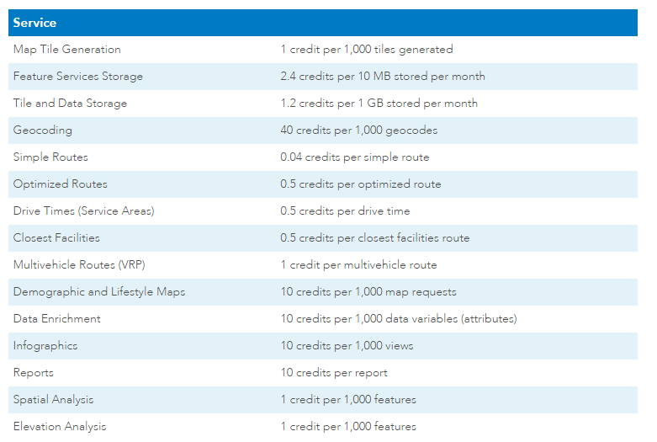
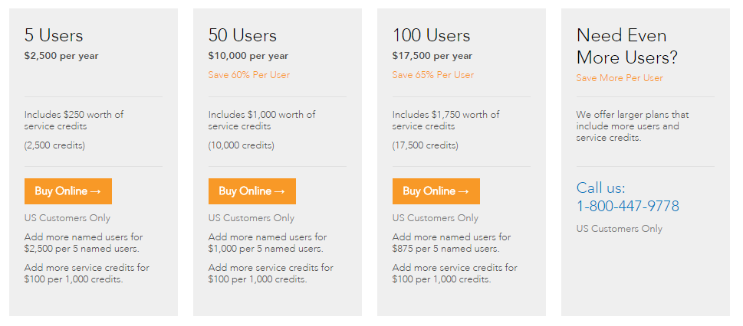
AGOL/Portal
Credits, users, $$$

Slide 42
AGOL/Portal
Frozen until cost and admin
issues are resolved
Contact me if you have AGOL
input or rely on it in your work

Slide 43
Custom Applications
HTML/CSS/JS using services

Slide 44
Custom Applications
HTML/CSS/JS using services
Easy to customize

Slide 45
Custom Applications
HTML/CSS/JS using services
Easy to customize
Infrastructure in place

Slide 46
Custom Applications
But… they require more time and expertise to do well.

Slide 47
Custom Applications
Templates to speed development

Slide 48
Demos!

Slide 49
Workflow
Join the ArcGIS Server Cadre!
Really, that’s how you get
permissions

Slide 50
Workflow - Service
Put your data and map in a folder under \\nasgisnp\entgis\cadre
Connect to the GIS Server http://darcgis.water.ca.gov/arcgis as a publisher and share your map as a service.
Analyze your map, respond to errors/warnings, tweak your service properties (ok to accept defaults), publish
Your service will be at https://darcgis.water.ca.gov/arcgis/rest/services/<folder name>/<service name>/MapServer

Slide 51
Workflow - App
Make a folder for your app at \\mrsbmapp21161\giswebapps
Create an HTML file named index.html
This file is accessible at http://darcgis.water.ca.gov/app/<your folder's name>

Slide 52
Workflow
Experiment within reason, you are in a development environment.
When it's time to go public, an ArcGIS Server admin (me) will work with you to push it to production.

Slide 53
Application Purpose
A sanctimonious denouement

Slide 54
Purpose
Effective web applications have clear purposes.

Slide 55
Purpose
Reason about app design

Slide 56
Purpose
Reason about app design
What layers? What tools? What styles? What capabilities?

Slide 57
Purpose
Reason about app design
What layers? What tools? What
styles? What capabilities?

Slide 58
Purpose
Pinpoint the business-case
e.g. saves staff time, makes data
more valuable, gets data to more
people, raises profile of section

Slide 59
Purpose
Pinpoint the business-case
e.g. saves staff time, makes data
more valuable, gets data to more
people, raises profile of section
Your boss cares about this

Slide 60
Training?
Publishing, writing code
Who wants to go?
Half/full day?
Late October/early November
Prerequisites

Slide 61
Questions?
https://github.com/wpears/webmap-brownbag
https://dwrgis.water.ca.gov/arcgis_server_cadre
https://dwrgis.water.ca.gov/library/-/document_library/view/4691500

